Slide 1
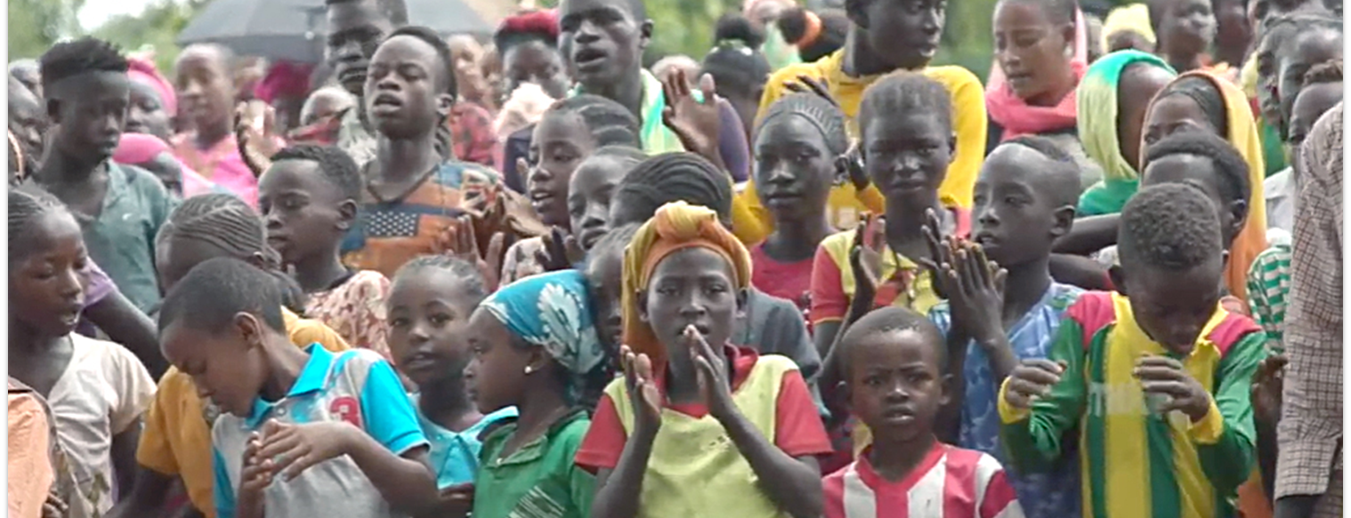
The things you heard from me among many witnesses, entrust them to faithful people who will be able to teach others also (2 Tim. 2:2).
All Scripture taken from the English Unlocked Literal Bible (ULB), ©2017, 2022 Wycliffe Associates, Available at https://bibleineverylanguage.org/translations, licensed under the Creative Commons Attribution-ShareAlike 4.0 International License.
The English ULB is based on the unfoldingWord® Literal Text, CC BY-SA 4.0. The original work of the unfoldingWord® Literal Text is available at https://unfoldingword.bible/ult/.
Sharing COBT with Others

Slide 2
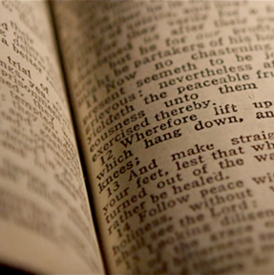
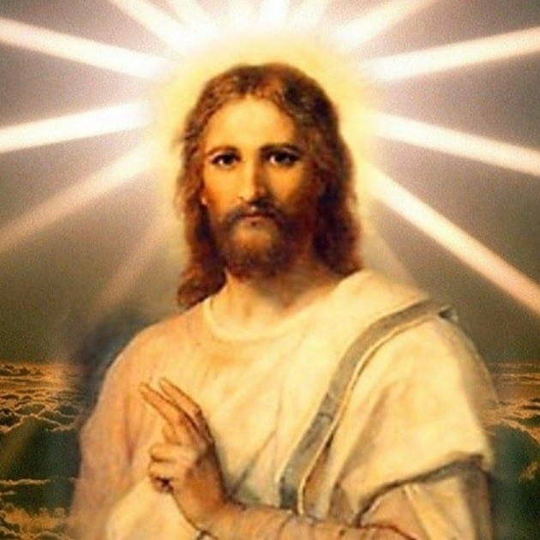
The Great Commission
Includes Bible Translation
Go therefore and make disciples of all the nations. Baptize them into the name of the Father, of the Son, and of the Holy Spirit. Teach them to obey all the things that I have commanded you. See, I am with you always, even to the end of the age (Matthew 28:19-20).
Romans
10:17
The Bible
Contains:
The Gospel
The Commands of Jesus

Slide 3
4 Beliefs
& 6 Behaviors
Ability
1. Translates Bible into heart language
2. Manages accessibility to the Bible
Authority
3. Refines and revises the translation
4. Engages community in Scripture usage
Responsibility
5. Shares COBT with others
Accountability
6. Owns generational revisions and updates

